Slide 1
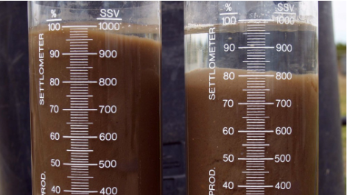

Predicting Sludge Volume Index at a Wastewater Treatment Plant
Nathan Jahns, M.Sc.
Data Science Intensive Capstone Project, Sept 23 Cohort

Slide 2
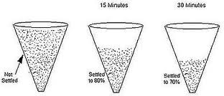
Background: Sludge Volume Index
Sludge is removed from wastewater before discharge at wastewater treatment plants (WTPs)
Sludge Volume Index (SVI) quantifies the separability of solids and liquids
Low values = optimal settling
High values = issues
Filamentous bacteria which impairs separation
SVI can change in response to waste quality and operations
Effective management ensures smooth WTP operation, conserves biomass, produces clear effluent, and meets regulatory compliance
Notes:
Efficient removal of sludge from wastewater to enable the safe discharge of clean water into nearby water bodies is a fundamental goal at WTPs. This process of separation is quantified using the SVI. SVI plays a crucial role in assisting WTP operators in assessing the efficacy of the activated sludge process. Elevated SVI values may signal underlying issues such as the overgrowth of filamentous bacteria, which can severely impair the separation of solids and liquids, consequently limiting the maximum flow capacity that the facility can effectively treat. Conversely, a low SVI indicates optimal settling conditions. Effective management of SVI not only ensures the smooth operation of the treatment process but also conserves biomass and results in the production of clear effluent, thus enhancing overall treatment efficiency and regulatory compliance. This metric serves as a valuable tool for troubleshooting operational issues and guiding adjustments to process parameters, ultimately optimizing wastewater treatment performance.

Slide 3
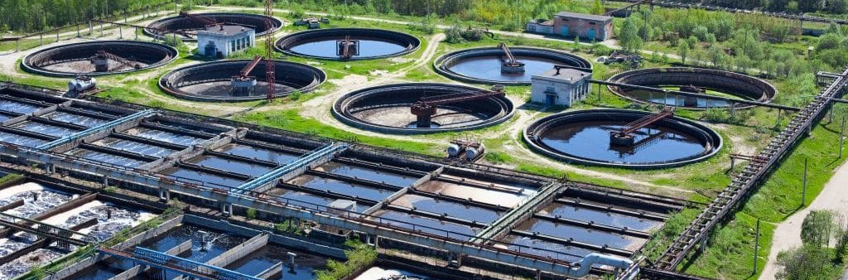
Objective
Develop machine learning model capable of forecasting SVI using explanatory variables that can be modified by a WTP operator
Dataset comprising daily wastewater measurements spanning five years at a fictitious WTP
Provide valuable insights to achieve more efficient sludge settling
Notes:
SVI can change slowly over time in response to changes in waste water and plant operations. In this project, I developed machine learning models to predict SVI using a dataset comprising daily wastewater measurements spanning five years at a fictitious WTP. The primary objective was to establish models capable of forecasting SVI using explanatory variables that can be modified by a WTP operator. By identifying and analyzing these controllable factors, the model can provide valuable insights to optimize treatment processes and achieve more efficient sludge settling, ultimately enhancing the overall performance of the wastewater treatment facility.

Slide 4
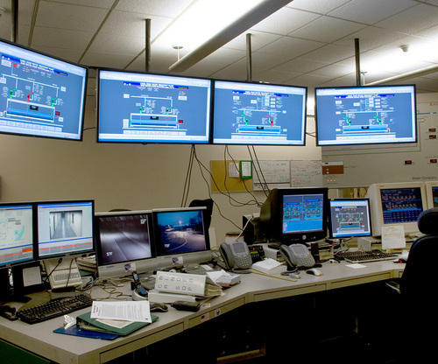
Data Wrangling
Data provided by WTP manager, 2,282 rows and 76 columns
Formatted data to floats
Confirmed one day frequency
No units - can’t confirming consistency
Notes:
Data Acquisition
Data was provided by the WTP manager in an excel file and consisted of 2,282 rows and 76 columns. The data contained two rows of column headers with one being the WTP metric name and the other indicating whether the metric is controllable by the operator.
Data Cleaning
The data came formatted in ‘object’ data type which could not be used in calculations. The index contained the sample dates which I changed to a ‘datetime64’ format while I changed the metric data to ‘float64’ format.
I investigated data frequency by subtracting one day from the next. This revealed that data had been collected daily and no days were missing. I also checked the data for duplicate rows and none existed.
The dataset does not include units unfortunately. Confirming consistency of units for a metric is important for data integrity. If found, inconsistent units and associated values can be converted to the appropriate unit. In addition, considering units and values in combination with knowledge of the metric is also helpful when determining the presence of outliers.

Slide 5
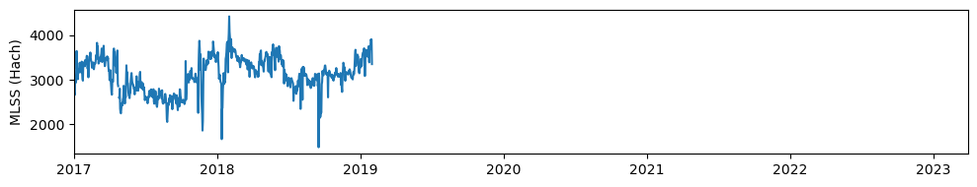
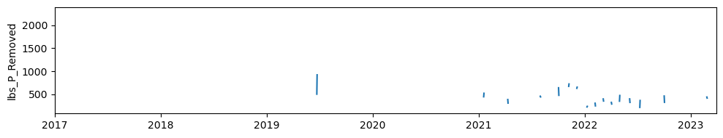
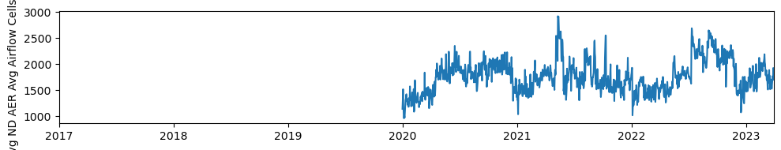
Data Cleaning
Removed metrics with high percentage of NaNs and/or large temporal gaps
Imputed missing values
Linear interpolation - calculates intermediate values between two known data points on a straight line
Both forward and backward directions from each NaN value
Notes:
I plotted the data in line graphs to investigate data gaps and calculated the percentage of NaNs to determine the usability of metrics. I then removed the metrics with a very high percentage of NaNs and/or with very large temporal data gaps from the dataset. Typical methods for imputting these large percentages or filling large gaps would not be reliable and may confound a future model.
As a last step of data organization, I imputed the missing values. For this step, I performed linear interpolation which calculates intermediate values between two known data points on a straight line. This method was more appropriate than others, such as imputing mean or median, as this is time series data and values are related to each other. Imputing was performed in both forward and backward directions from each NaN value.

Slide 6
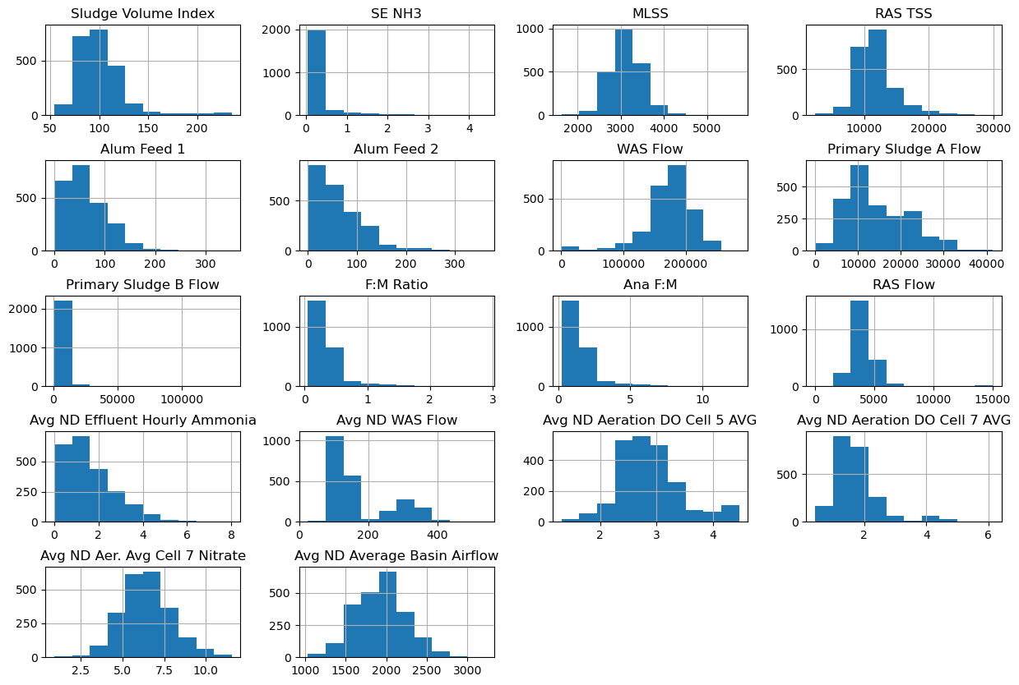
Exploratory Data Analysis: Distribution
Examining distribution of metrics
Min, max, mean
Plotted histograms
Shapiro-Wilk tests
Not normally distributed
Notes:
I began EDA by examining the distribution of the data. I described the metrics for min; max, and mean; plotted histograms of the metrics, and ran a Shapiro-Wilk test for each metric. These assessments indicated none of the metrics were normally distributed. Therefore, the median values were used to explore the data further.

Slide 7
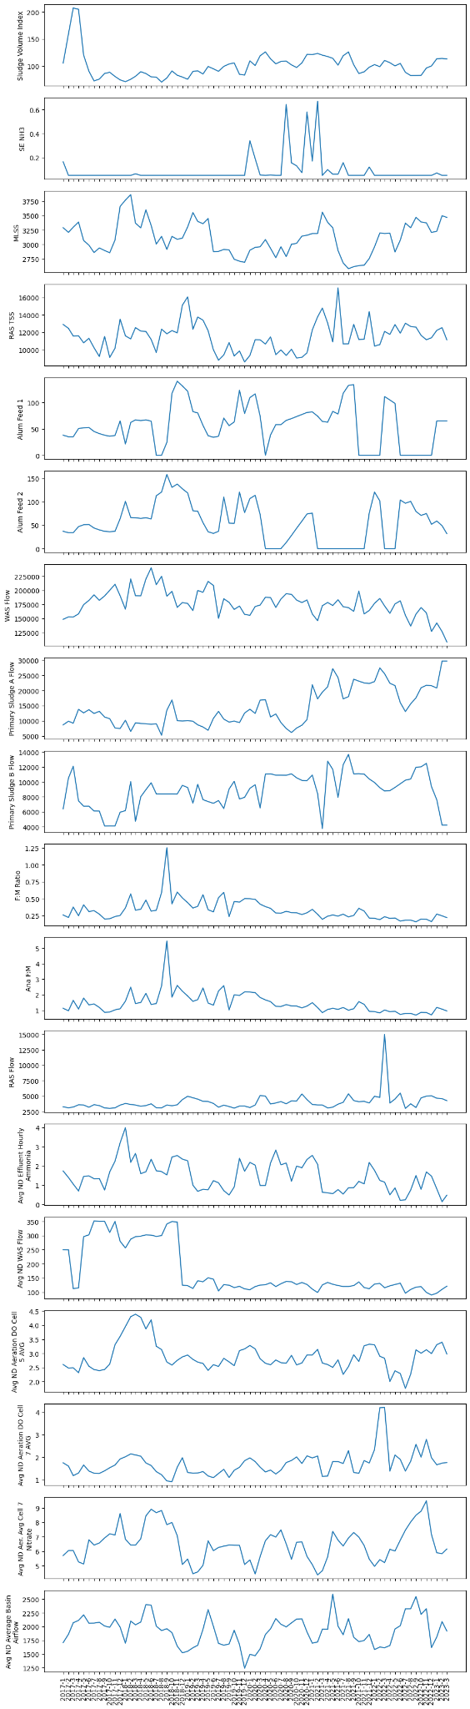
Exploratory Data Analysis: Visualization
Plotted line plots of median monthly metrics
Visually assessed for trends (directional, seasonal) and stationarity
‘ANA F:M’ and ‘F:M Ratio’ are the same
Decreasing in ‘WAS flow’ and increase in ‘Primary Sludge A Flow’ from mid 2018 to 2023
Many metrics relatively large in 2017/2018
Metrics appeared to be stationary
Notes:
I again plotted line graphs of the metrics but this time in a “smoother” format. First, I added a year column to the dataset, grouped data by year and month, and calculated the median. These “smoothed” figures with no data gaps were easily visually assessed for trends (directional, seasonal) and stationarity. Most obviously, I discovered that the ‘ANA F:M’ and ‘F:M Ratio’ graphs appeared exactly the same. A decreasing trend in ‘WAS flow’ and increase in ‘Primary Sludge A Flow’ from mid 2018 to 2023 was identified. In addition, many metrics had relatively large values in 2017 and 2018. A few metrics display seasonality. In addition, some metrics displayed minimal time dependent variance but, overall, metrics appeared to be stationary.

Slide 8
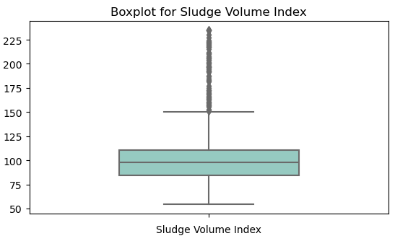
Exploratory Data Analysis: Visualization
Created boxplots
Some metrics had extreme values but most were not greater than three standard deviations from the median
No reason to believe eronious
Did not remove any values as outliers
Notes:
I also created boxplots for each metric to investigate data distribution. Many metrics had extreme values, however, the majority were not greater than three standard deviations from the median which is a common threshold for removing outliers. In addition, I have no reason to believe that any of these values were erroneous.

Slide 9
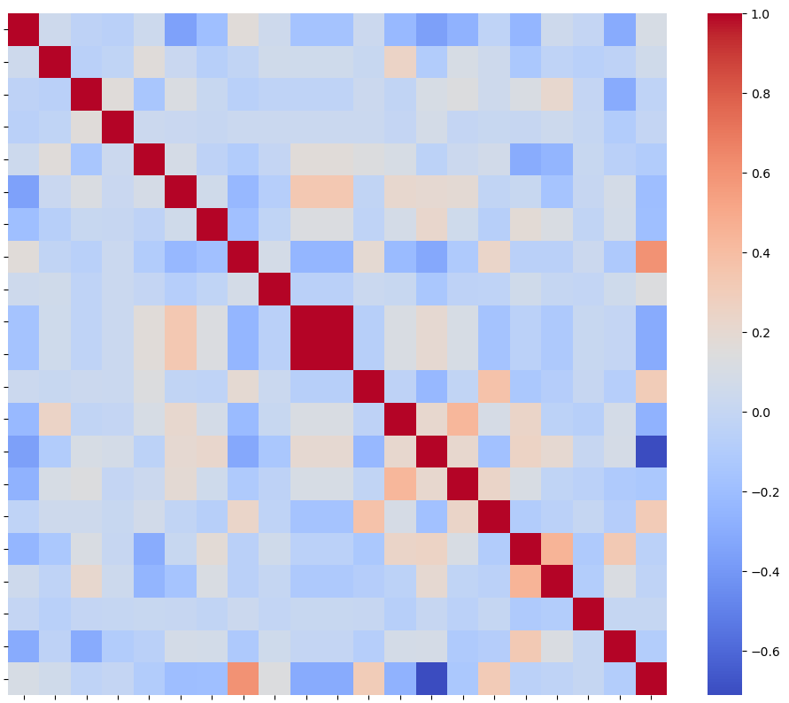
Exploratory Data Analysis: Correlations
Correlation heatmap
Weak correlation between SVI and other metrics
‘ANA F:M’ and ‘F:M Ratio’ are perfectly correlated
Removed ‘F:M Ratio’ from the dataset
Few other moderate correlations
Pairplot agreed
Notes:
I created a correlation heatmap between metrics to investigate linear relations between metrics, specifically SVI. Heatmaps are an effective way to visualize many correlations at once, making it easy to identify correlations and patterns in correlations. The heatmap showed weak correlation between SVI and other metrics. Between all other metrics, ‘ANA F:M’ and ‘F:M Ratio’ are perfectly correlated as expected. As ‘F:M Ratio’ measures both aerobic and anaerobic treatment, this perfect correlation would indicate that no aerobic treatment is occuring. I, therefore, removed ‘F:M Ratio’ from the dataset as it adds no more information to the model. In addition, ‘Primary sludge flow A’ is positively correlated with year and ‘Avg ND WAS Flow’ is negatively correlated with ‘year’ but only moderately.
Pairplot gave same information.

Slide 10
Feature Engineering
Used existing data to calculate additional WTP metrics
Performed differencing
Makes stationary and remove seasonality trends
Created lagged versions of data
Incorporates temporal relationships
New Metric | Calculation
Total Alum Feed | Alum Feed 1 + Alum Feed 2
Total Primary Sludge Flow | Primary Sludge A Flow + Primary Sludge B Flow
Ave ND Aeration DO in Cells | (Avg ND Aeration DO Cell 5 AVG + Avg ND Aeration DO Cell 7 AVG) / 2
MVLSS | MLSS x 0.75
MCRT | MVLSS / (Activated Sludge Flow + RAS Flow)
Sludge Age | MCRT / (1 + F:M Ratio)
Notes:
As part of feature engineering, I used existing data to calculate additional WTP metrics based on domain knowledge (Table 2). These metrics are commonly recorded by WTPs.
I then performed differencing on the original and these new metrics to compute the differences between consecutive data points. This technique is often performed for time series models and can transform a non-stationary time series into a stationary series and remove trends and seasonality. Overall, differencing can be beneficial because it stabilizes the mean and variance of the data, making it easier to identify underlying patterns and relationships.
Creating lagged versions of data is also a common technique performed for time series models and incorporates temporal relationships involving past values into the model. SVI tends to change over the course of weeks so I created one through seven day lags which was done simply by copying and shifting the columns in the dataframe the appropriate number of days.

Slide 11
Pre-processing
Defined multiple versions of predictor variables, X
Try different combinations of independent variables
Reduced size of dataset to prevented the curse of dimensionality and overfitting
Original data, differenced, and lagged data containing and not containing SVI
Defined multiple versions of target variables, y
Original SVI
SVI shifted forward one day
Avoids potential data leakage
Notes:
I defined multiple versions of X and y for use in my models. I did this for the X data to try different combinations of independent variables in the models. This also reduced the size of the dataset which prevented the curse of dimensionality and overfitting. These data consisted of original data (including the additional WTP metrics I calculated) and specific orders of differenced and lagged data containing and not containing SVI. I didn’t create every possible combination of these data groups, but rather a range so that I could hone in on specific combinations when running the models. For instance, I made a data set of data with a one day lag, a set with four day lag, and with seven day lag. That way, a model performing, for instance, well with one and four day lag data but poorly with seven day lag data, would direct me to try the model with two or three day lag data. As for y data, I defined a dataset of original SVI and SVI shifted forward one day. The latter was created to avoid any potential data leakage.

Slide 12
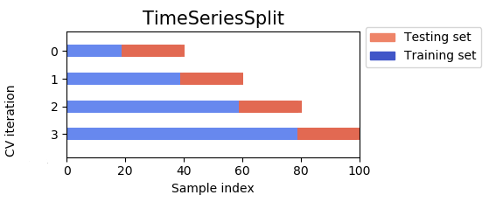
Modeling
ARIMAX, linear regression, and random forest models
Cross-validation with TimeSeriesSplit
Specific for time series and avoids overfitting
Squared error (RMSE) and adjusted R squared (R2adj)
ARAMEX
Included exogenous features
Auto ARIMA to choose the most appropriate p, d, and q hyperparameters
Run with combinations of my different X and y versions
ARIMAX model used the Xs that did not include differenced and lagged SVI
Notes:
Models capable of making predictions from time series data were essential for this project. I chose to explore ARIMAX, linear regression, and random forest models.
For each model, rather than splitting, training, and testing once, cross-validation was performed to divide the data into 5 subsets and training and testing were performed five times using a different subset for testing each time. I specifically used TimeSeriesSplit() for my cross-validation because this function is specifically designed for time series data. Each fold is a superset of the previous one, ensuring that the model is trained on data that retains the temporal nature of time series data. Predictions were then made and each fold was scored and averaged for a final score. This process avoids overfitting the model to the data and thus makes it more generalized for future data.
The scores I used were root mean squared error (RMSE) and adjusted R squared (R2adj) were calculated. RMSE was calculated to measure the error between the model's predictions and the actual values. R2adj was calculated to measure the proportion of the variance in SVI that is explained by the features and adjusted to account for the large number of predictors in the model. I chose to adjust the R2 because the R squared value of a model can increase as predictors are added to a model even if they are not contributing to the explanatory power of the model. Adjusting the R-squared corrects this.
Other than being performed with cross-validation, the three models were mostly out of the box. The exception being that the ARAMAX model included exogenous features, in contrast to the simpler ARIMA model which only uses the target variable. Before fitting this model, I used auto ARIMA to choose the most appropriate p, d, and q hyperparameters for the model.
Each of the models were run with combinations of my different X and y versions. The linear regression and random forest models used the Xs that included differenced and lagged SVI data while the ARIMAX model used the Xs that did not include differenced and lagged SVI. The ARIMAX model does not need to be fed differenced and lagged versions of the target variable because it creates its own. All models were run with original SVI and SVI shifted as the y.

Slide 13

Results
ARIMAX
Perform poorly with all data
Linear Regression
Perform moderately poor with shifted y and a lag of 1 day data
RMSE 8.76
R2adj 0.16
Lag of 4 days was slightly worse followed by lag of 7 days
Ran models with lag of 2 days and lag of 3 days
Not as good as 1 day
Notes:
Lastly, the RMSE and R2adj scores (Table 3) from running ARIMAX models with the various data indicated that the models:
Perform poorly with all data,
Are not improve by differencing the data,
Perform slightly better with shifted y values than not shifted.
This information indicated that I did not need to run the model again with different features because no additional data is expected to produce a better ARIMAX model. Overall, these scores indicate that ARIMAX models do not provide a good fit to the data and perform worse than a simple mean prediction model as indicated by the negative R2adj scores.
The RMSE and R2adj scores from running linear regression models with the various data indicated that the models:
Perform poorly with the original data and a lag of 4 and 7 days,
Are not improve by differencing the data,
Perform moderately well with shifted y and a lag of 1 day data (considering a mean SVI of 101 and max of 235),
Appear to suffer from data leakage when y is shifted and lag of 1 day is used,
Perform better when y is shifted than when it is not in combination with lag data.
This information indicated that I should run models with a combination of shifted y data and lag of 2 days and lag of 3 days. The models perform:
Moderately well with lag of 2 days,
Poorly with a lag of 3 days.
Overall, the highest performing linear regression model used shifted y data and a lag of 1 day. The RMSE indicated that the error between the model's predictions and the actual values was small. Adjusted R squared, on the other hand, indicated that the model explains only 16% of the variance in the target variable.

Slide 14

Results: Random Forest
Perform very well with shifted y and a lag of 1 day data
Error between the model's predictions and the actual values was very small
RMSE 0.54
The model explains almost 97% of the variance in the target variable
R2adj 0.97
Notes:
The RMSE and R2adj scores (Table 3) from running random forest models with the various data indicated that the models:
Perform poorly with the original data and a lag of 4 and 7 days,
Are only slightly improve by differencing the data, although they still perform poorly,
Perform better with shifted y data than with non shifted y data in combination with lagged data,
With a lag of one day, perform moderately well with not shifted y and very well with shifted y.
This information indicated that I did not need to run the model again with different features because I already found a very good model.
Overall, the random forest model using non shifted y data and a lag of 1 day performed best. The RMSE indicated that the error between the model's predictions and the actual values was very small. In addition, the R2adj indicated that the model explains almost 97% of the variance in the target variable.

